Slide 1
STUDENT ATTENDANCE MANAGEMENT SYSTEM
SUBMITTED BY:
ALONA MARY SHAIBY
NO:10
CS DEPT
17/07/2024

Slide 2
INTRODUCTION
OVERVIEW
The Student Attendance Management System is a software application designed to help educational institutions manage and track student attendance. The system allows teachers to record student attendance, generate reports, and analyse attendance data to ensure students meet academic requirements.
PROBLEM STATEMENT
Student attendance management system plays a crucial role in schools & colleges to track student attendance. But it can be a time-consuming process especially when there are more students and it can sometimes disrupt learning process. Therefore, a system is designed to automate and streamline the track of student attendance. It should be developed using the C programming language to leverage its efficiency & control over hardware resources. It helps to substitute digital platforms for paper attendance records. It also makes it simpler for teachers to track attendance.
OBJECTIVES
The primary objectives of the Student Attendance Management System are:
To automate the process of recording and managing student attendance.
To provide an user-friendly interface to input attendance data.
To generate reports on student attendance for analysis and record-keeping.

Slide 3
SYSTEM SPECIFICATIONS
HARDWARE REQUIREMENTS
1.User’s Laptop specifications:
* Operating System : Windows 11
*Processor : corei5
*RAM :16GB
*Storage :512GB SSD
SOFTWARE REQUIREMENTS
1.Operating System : Windows 11
2.Development Environment:
C compiler : GCC
IDE : Code : Visual Studio Code

Slide 4
DESIGN AND DEVELOPMENT
Attendance management is crucial in educational institutions for monitoring student participation. This system replaces the manual attendance process with a digital solution, reducing errors and saving time.This project involves the development of a Student Attendance Management System using the C programming language. The system aims to automate the process of recording andmanaging student attendance, offering a userfriendly Interface for both administrators and usersThe main functions include:
Student Registration: Allows new students to be added to the system.
Attendance Marking: Record attendance for students.
Attendance Reports: Generate reports based on attendance records.

Slide 5
PSUEDOCODE
Student Structure: Contains student ID, name,and other relevant details.
struct Student {
int id;
char name[50];
// Additional fields
};
Implementation:The implementation involves the creation of several functions to handle different operations.
Register Student: Adds a new student to the system.
Mark Attendance: Records attendance for a specific date.
Generate Report: Displays attendance records.

Slide 6
START
int main() {
int choice;
do {
Display("\nAttendance Management System:\n");
Display("1. Input student data\n");
Display("2. Generate attendance report\n");
Display("3. Exit\n");
printf("Enter your choice: ");
scanf("%d", &choice);
switch (choice) {
case 1: inputStudentData();
case 2: AttendanceReport();
case 3:
printf("Exiting program.\n");
default: printf("Invalid choice. Please enter again.\n");
while (choice != 3);
return 0;
STOP

Slide 7
Input Student Data
void inputStudentData()
if (num_stds < MAX_STUDENTS)
Input student id and store in students[num_stds].s_id
Read student name.And store in students[num_stds].name.
for (int day = 0; day < MAX_DAYS; ++day) {
Read the attendance per day and store in students[num_stds].attendance[day].
Increment numofstudents
else
Display("Maximum number of students reached.\n");
Attendance Report
void AttendanceReport()
for (int i = 0; i < num_stds; ++i)
int p_count = 0;
for (int j = 0; j < MAX_DAYS; ++j)
if (students[i].attendance[j] == 1)
p_count++;
float attendance_percentage = (float)p_count / MAX_DAYS * 100.0;
printf("Student ID: %d, Name: %s, Attendance: %.2f%%\n", students[i].s_id, students[i].name, attendance_percentage);

Slide 8
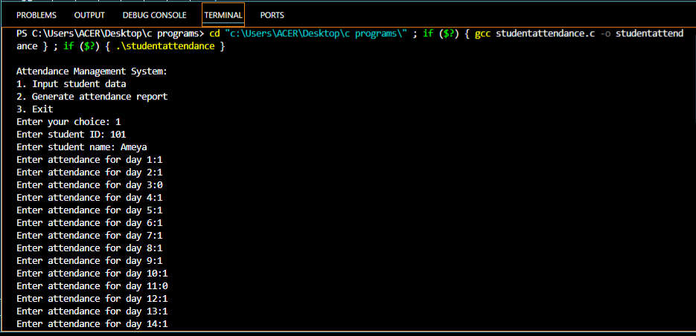
TESTING & RESULTS
Testing :The system was tested using various scenarios including: Adding multiple students and recording their attendance. Recording both presence and absence. Generating reports for different students to verify the accuracy of attendance records.
Results:The output is displayed below;

Slide 9
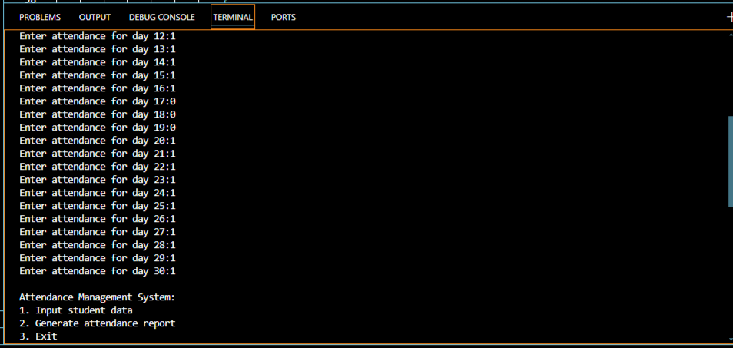

Slide 10
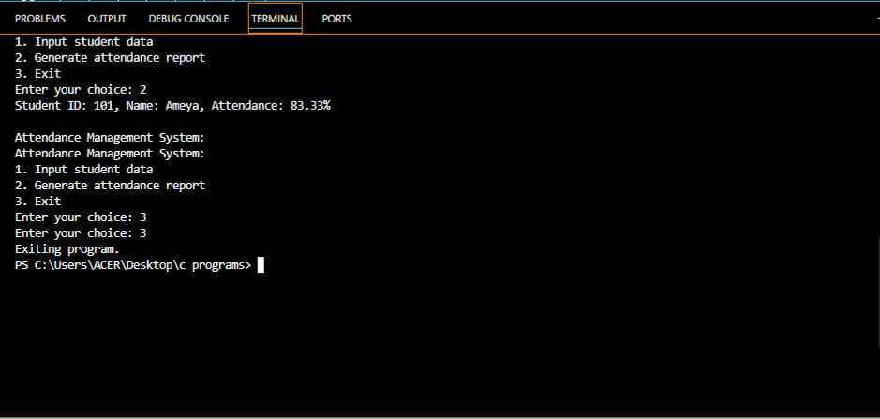

Slide 11
CONCLUSION
SUMMARY
The Student Attendance Management System implemented in C effectively fulfills the requirements for recording and managing student attendance. It demonstrates the use of basic C programming constructs including data structures and procedural functions. While the system is functional, it can be further enhanced with features such as a graphical user interface, advanced reporting, and integration with other academic systems.
FUTURE ENHANCEMENT
Developing a graphical user interface, adding more features like notifications for low attendance, integrating with a database for better data management, adding user authentication for teachers and administrators.

